Slide 1
EmoSense: Real-Time Facial Emotion Detection and Analysis
PRESENTED BY:
NAME | ROLL NO
KASHISH BARTHWAL | 2210990495
JOEL MATTHEW | 2210990465
JUGAL KISHOR | 2210990467
KSHITIJ GULATI | 2210990525
Under the supervision of
Mrs. Shagun Sharma
Chitkara University Institute of Engineering and Technology
Chitkara University, Punjab

Slide 2
OVERVIEW
INTRODUCTION EMOTION RECOGNITION
CLASSIFICATION VISUALIZATION
METHODLOGY
CODE SNIPPETS
FACE DETECTOR DEMO

Slide 3
INTRODUCTION
Welcome to our Python project where we explore the magic of emotions through the eyes of technology! Have you ever wondered if a computer could understand how you're feeling, just by looking at your face? Well, get ready to be amazed because that's exactly what we're going to do!
In this project, we'll be using a cool programming language called Python, along with an awesome library called OpenCV, to create something super cool: an Emotion Detector. Sounds fancy, right? Don't worry, it's not as complicated as it sounds!
Basically, we'll teach the computer to recognize different facial expressions like smiles, frowns, or surprised faces. We'll then use this knowledge to make our computer guess how someone is feeling just by looking at their face! It's like teaching a robot to read minds, but way more fun!
So, get ready to dive into the exciting world of Python programming and let's have some fun exploring emotions together!

Slide 4
PROBLEM STATEMENT
The objective of this project is to develop an Emotion Detector using Python and OpenCV that can accurately recognize and classify basic human emotions such as happiness, sadness, anger, surprise, fear, and neutrality from facial expressions captured through images or live video streams. The Emotion Detector should be capable of real-time performance, ensuring smooth and efficient emotion recognition.

Slide 5
WHAT IS FACIAL EMOTION RECOGNITION?
• Facial emotion recognition is the process of detecting human emotions from facial expressions. The human brain recognizes emotions automatically, and software has now been developed that can recognize emotions as well. This technology is becoming more accurate all the time, and will eventually be able to read emotions as well as our brains do.
• AI can detect emotions by learning what each facial expression means and applying that knowledge to the new information presented to it. Emotional artificial intelligence, or emotion AI, is a technology that is capable of reading, imitating, interpreting, and responding to human facial expressions and emotions.

Slide 6
OTHER APPLICATION OF EMOTION FACIAL RECOGINITION
Market Research: Companies have traditionally done market research by conducting surveys to find out about what consumers want and need. This method however, assumes that the preferences stated are correct and reflect future actions. But this is not always the case.
Another popular approach in market research is to employ behavioral methods where user’s reactions are observed, while interacting with a brand or a product. Although effective, such techniques can quickly become very labor intensive as the sample size increases. In such circumstances, facial expression recognition technology can save the day by allowing companies to conduct market research and measure moment-by-moment facial expressions of emotions automatically, making it easy aggregate the result.

Slide 7
CONT.
Video Game Testing: Facial expression recognition can also be used in the video game testing phase. In this phase, usually a focus group of users is asked to play a game for a given amount of time and their behavior and emotions are monitored. By using facial expression recognition, game developers can gain insights and draw conclusions about the emotions experienced during game play and incorporate that feedback in the making of the final product.
Facial expression analysis is a practical means of going beyond the typical survey approach. It is a way of appreciating what the user is experiencing, all while getting feedback. When feedback is taken in this format, it becomes genuinely non-intrusive when it comes to user experience.

Slide 8
OVERVIEW OF THE DATASET
The Face expression recognition dataset consists of 28,821 labeled images in the training set, 3,500 labeled images in the development set, and 3,500 images in the test set. Each image in dataset is labeled as one of seven emotions: happy, sad, angry, afraid, surprise, disgust, and neutral, with happy being the most prevalent emotion, providing a baseline for random guessing of 24.4%.
The images in dataset consist of both posed and unposed headshots, which are in grayscale and 48x48 pixels.
The dataset was created by gathering the results of a Google image search of each emotion and synonyms of the emotions

Slide 9
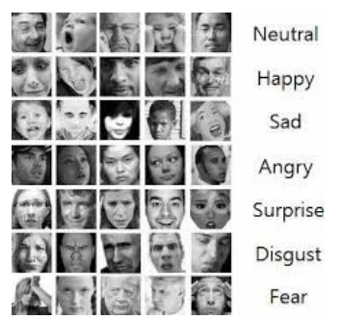
PROBLEMS IN DATASET
PROBLEMS IN DATASET
Imbalance Dataset
Intraclass Variation
Contrast
Eye-Glasses
Outlier/Null Values

Slide 10

DEPENDENCIES
DEPENDENCIES
Opencv
Tensorflow
Keras
pandas
numpy
Jupyter notebook

Slide 11
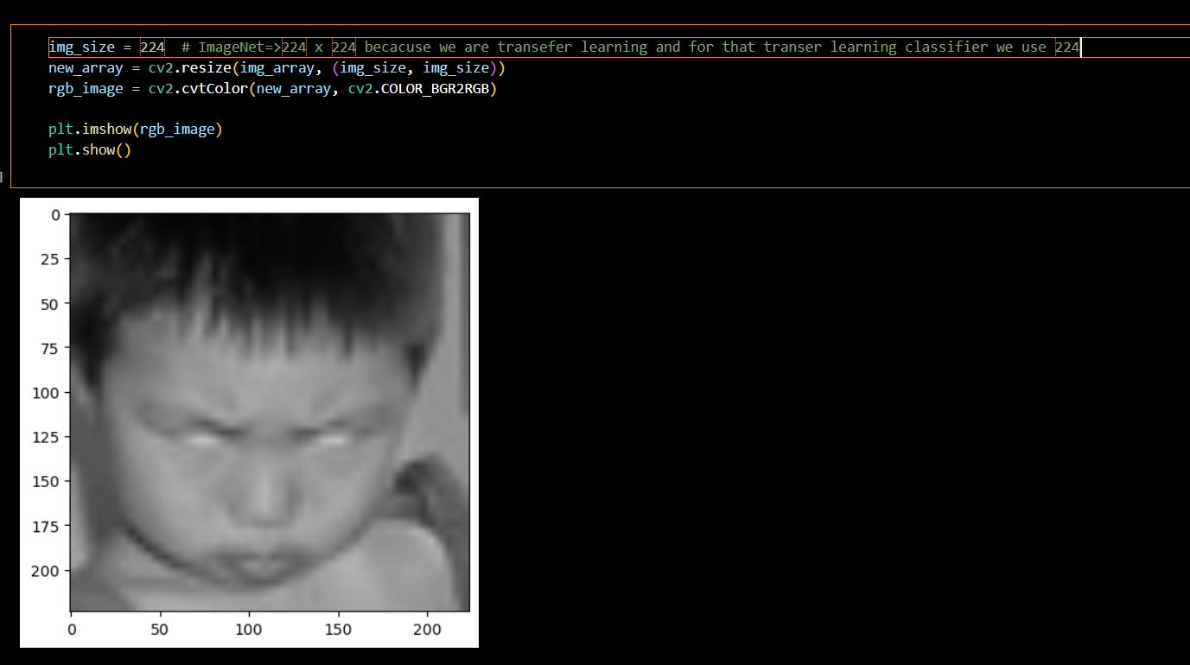
RESULT

Slide 12
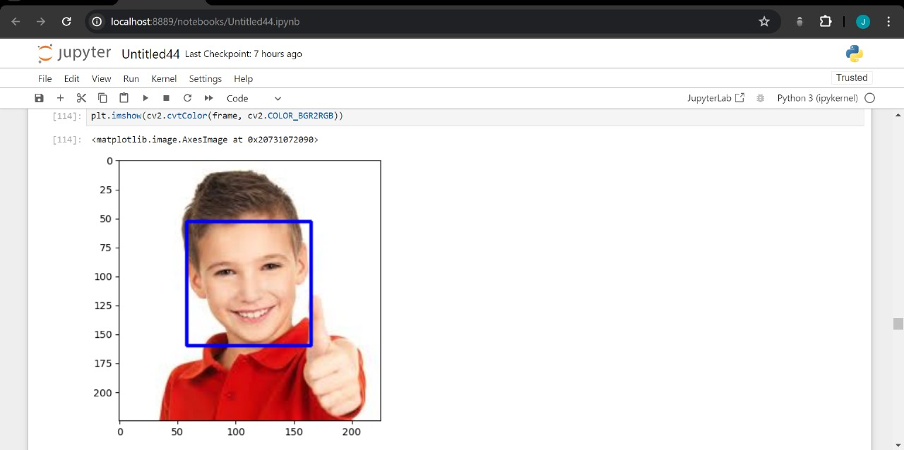
RESULT

Slide 13
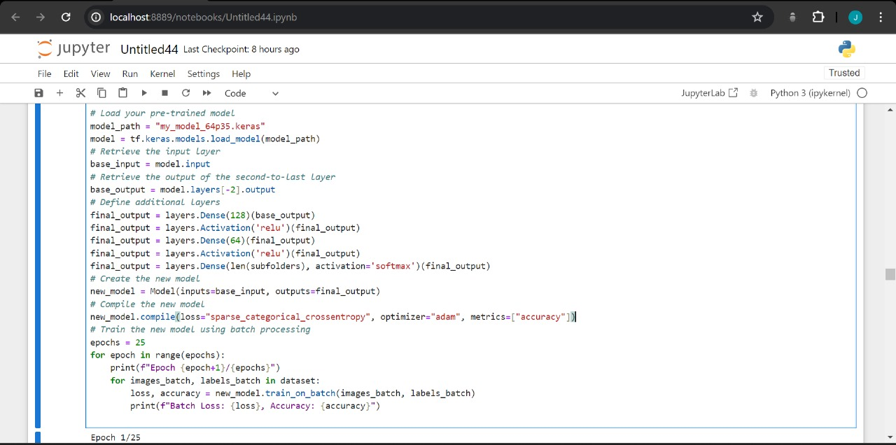
MODEL TRAINING

Slide 14
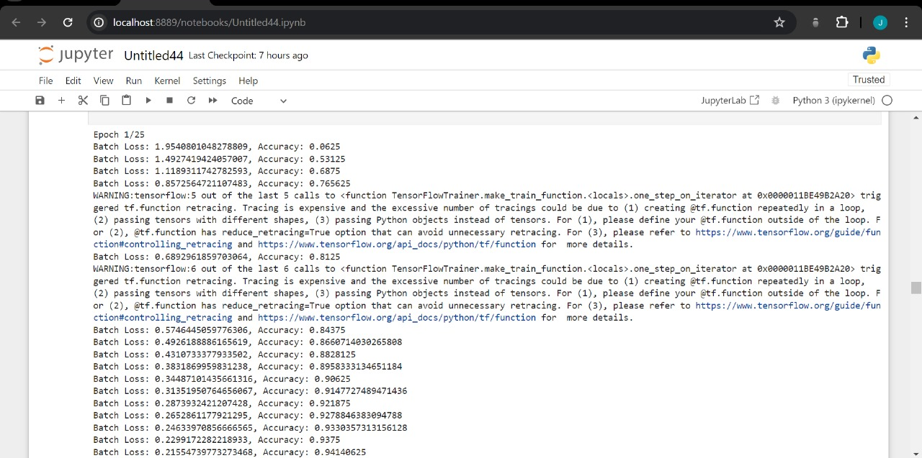

Slide 15
CONCLUSION
CONCLUSION
Can get input from different camera’s
Use face detection

Slide 16
References
Data set :
https://www.kaggle.com/datasets/jonathanoheix/face-expression-recognition-dataset/code

Slide 17
Thanks...

